Slide 1

Welcome to Year 2!
Please take a seat ☺

Slide 2
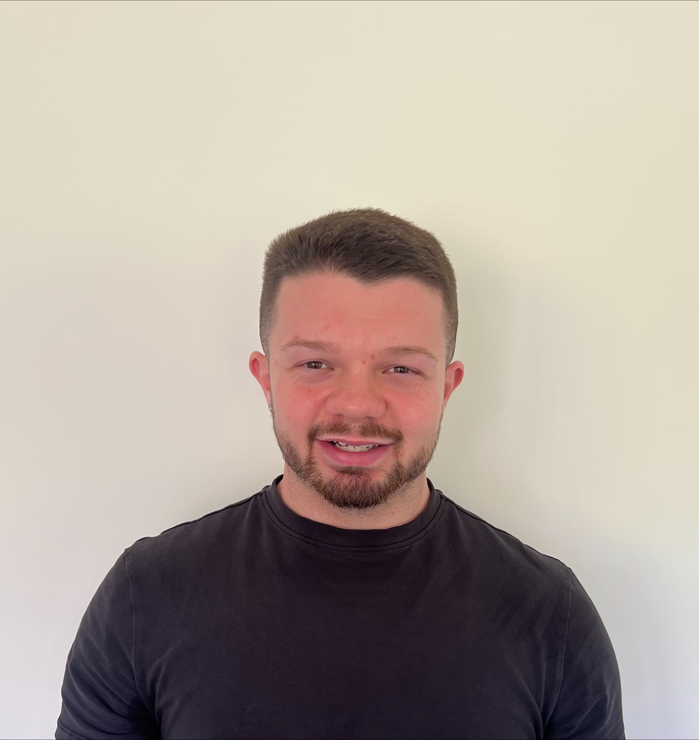
Staff you will see….
Mr Bradshaw
Blackbird’s Class Teacher
Miss Henderson
Starling’s Class Teacher

Slide 3
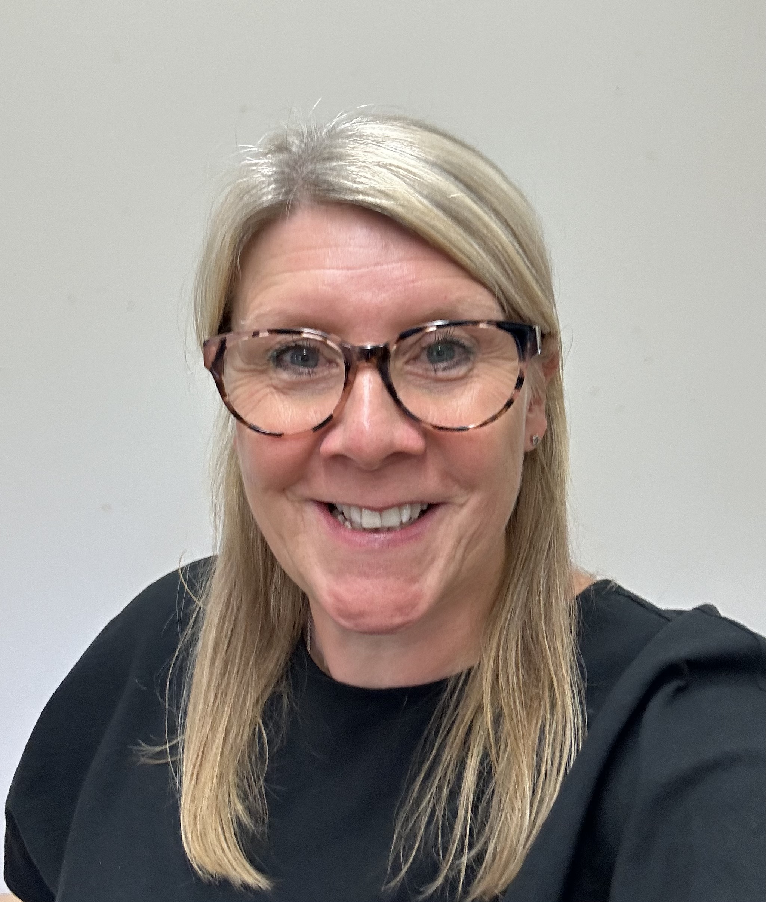
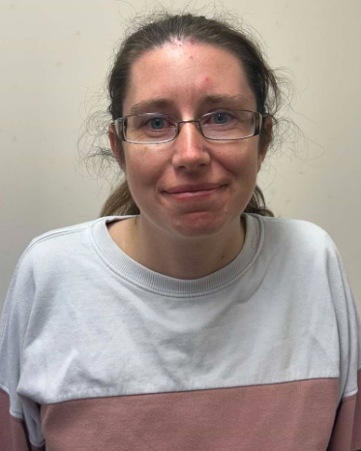
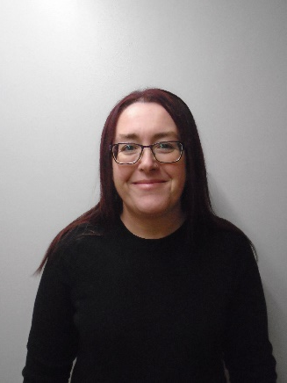
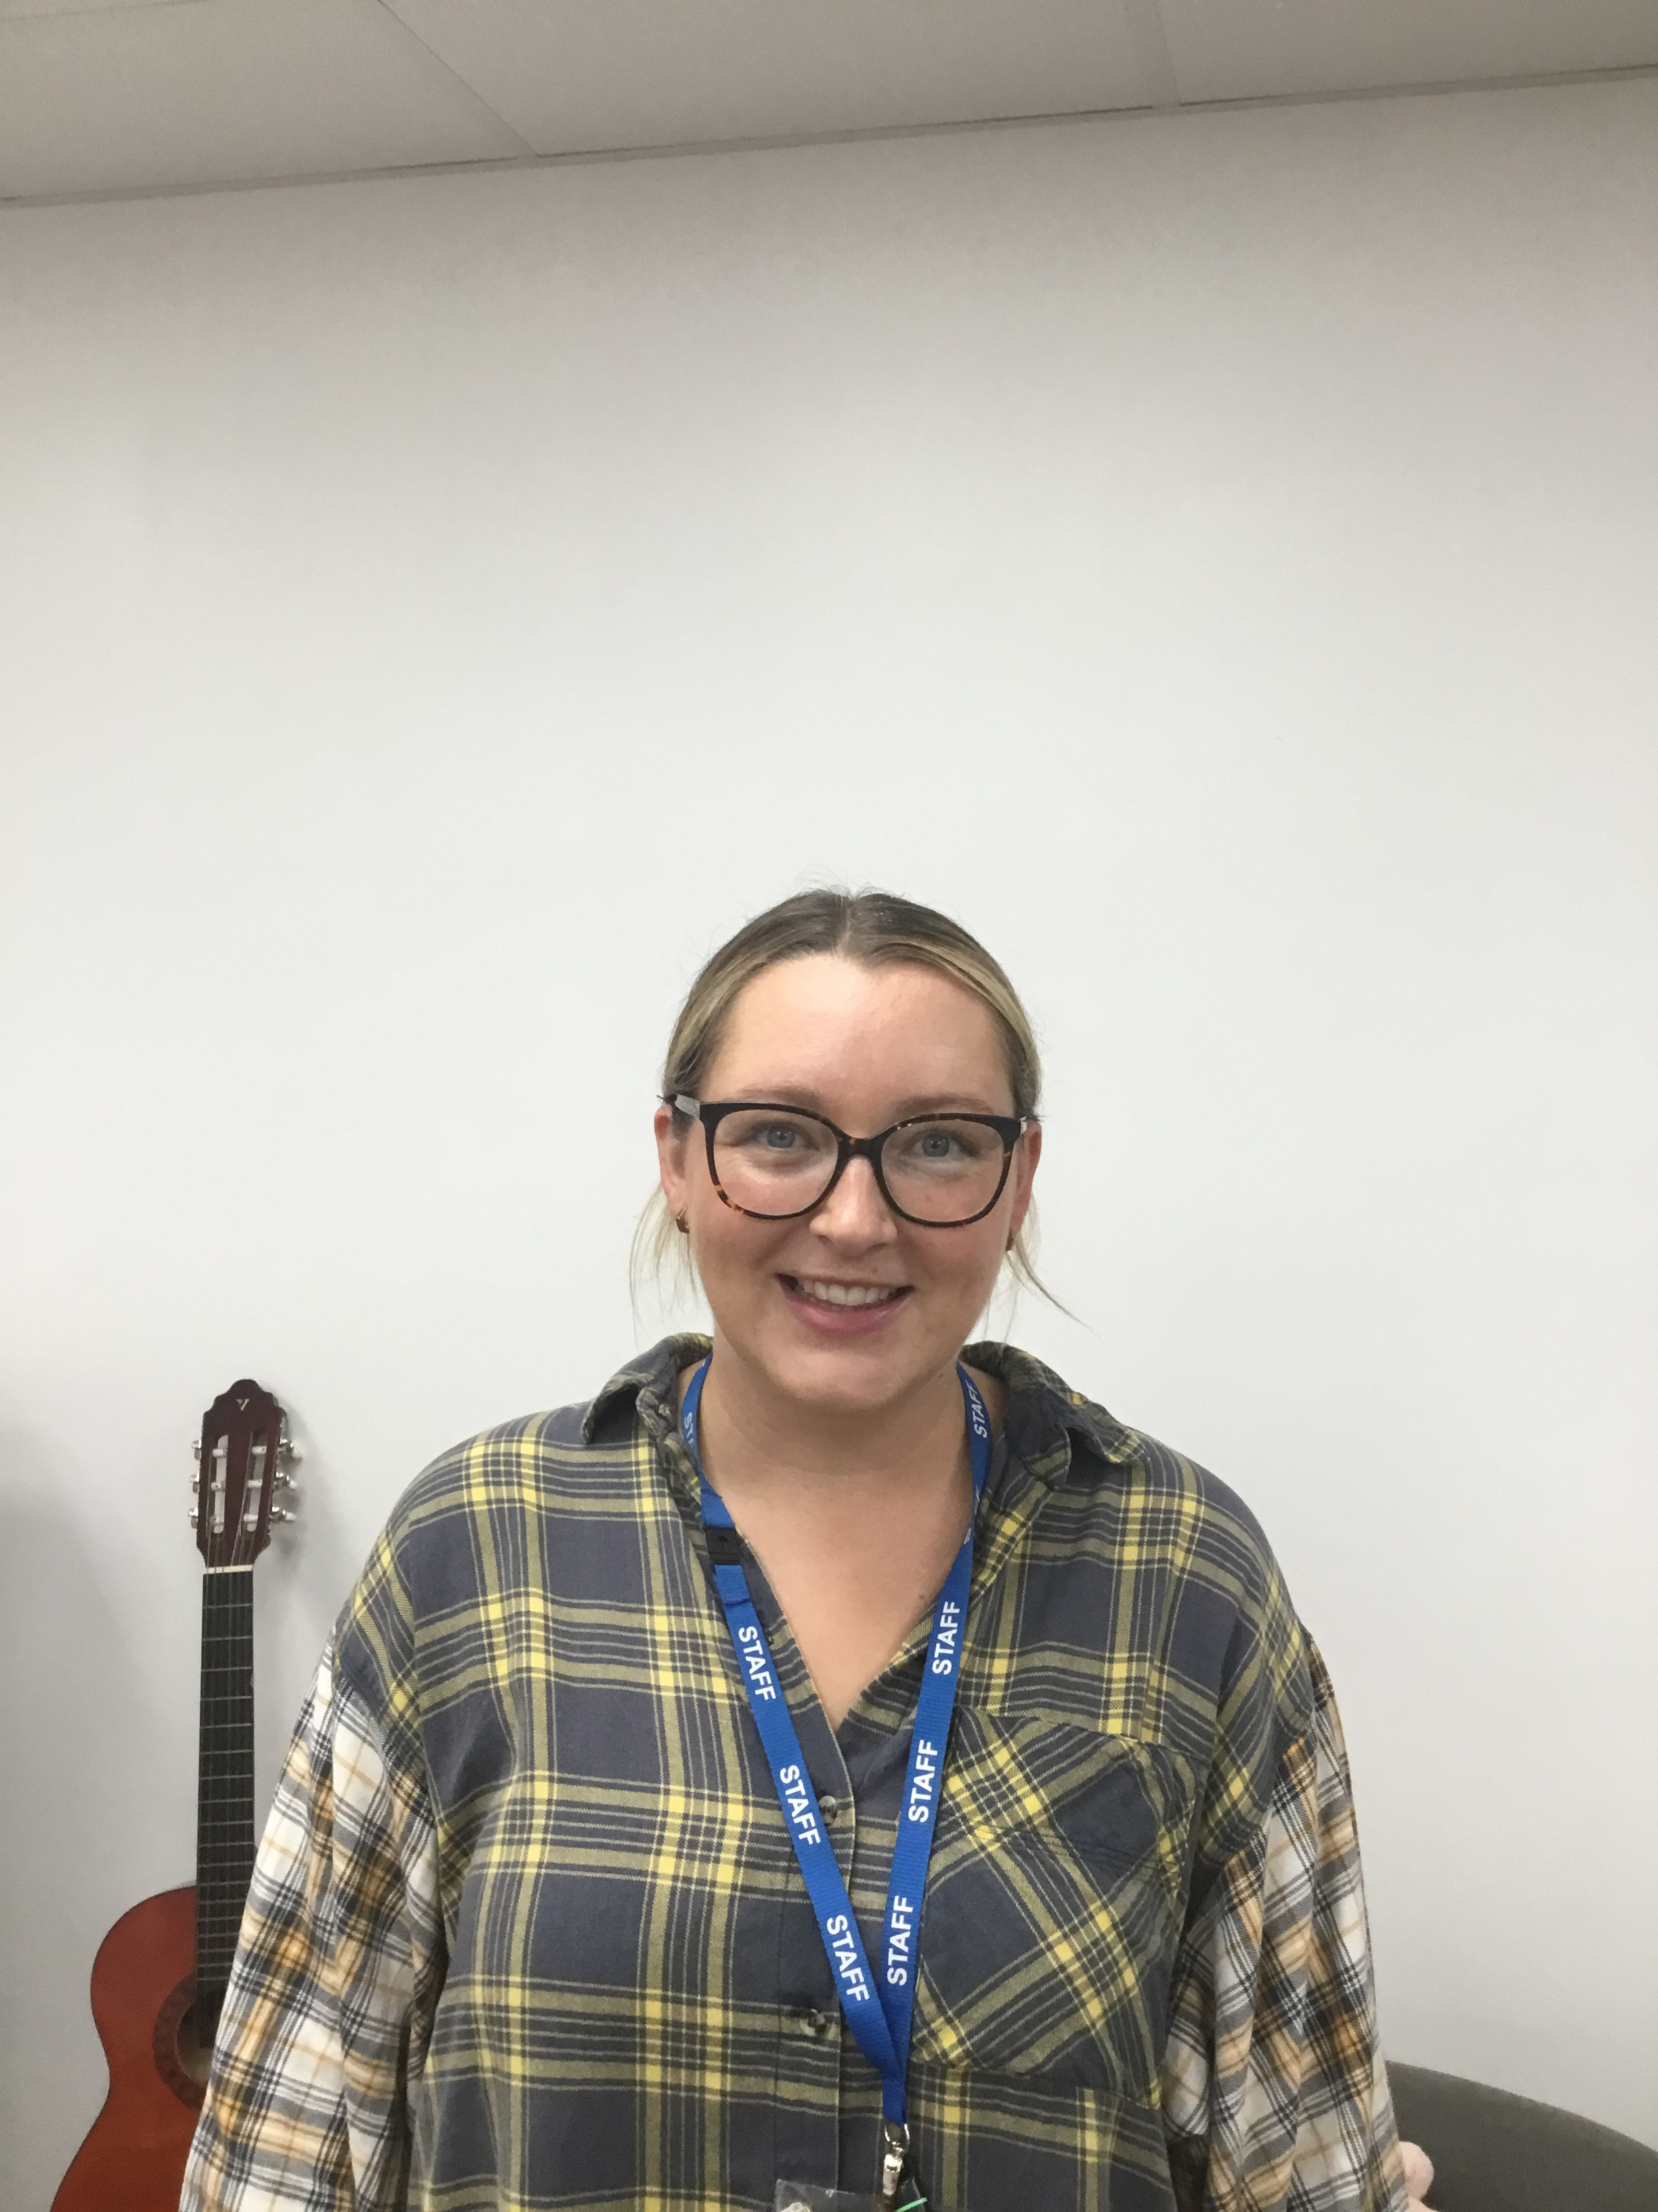
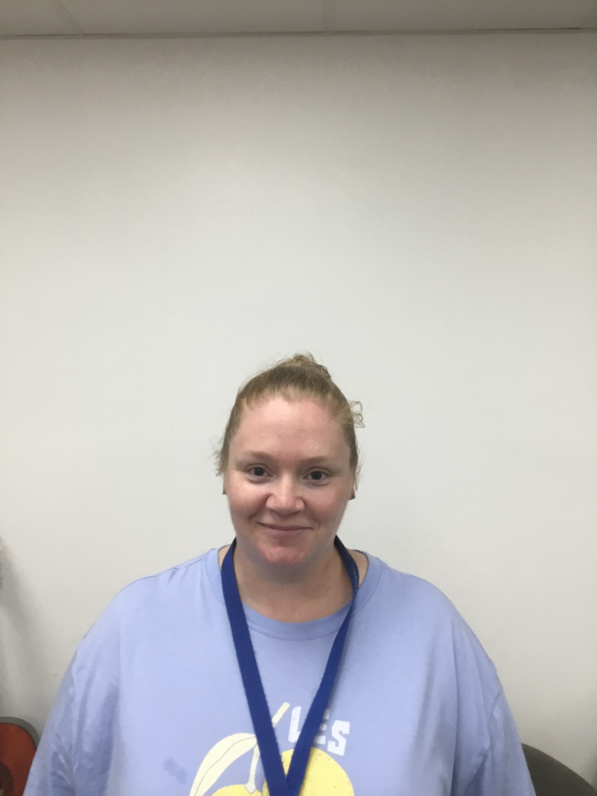
Staff you will see….
Mrs Crawley
Teaching assistant
Mrs Harrison
Miss Tarsey
Mrs Wardle
Learning Mentor
Miss Adkin
Assistant Learning Mentor
Mrs Harrison
Learning Support Assistants

Slide 4
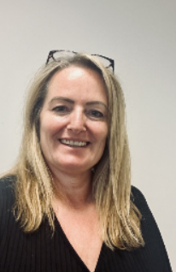

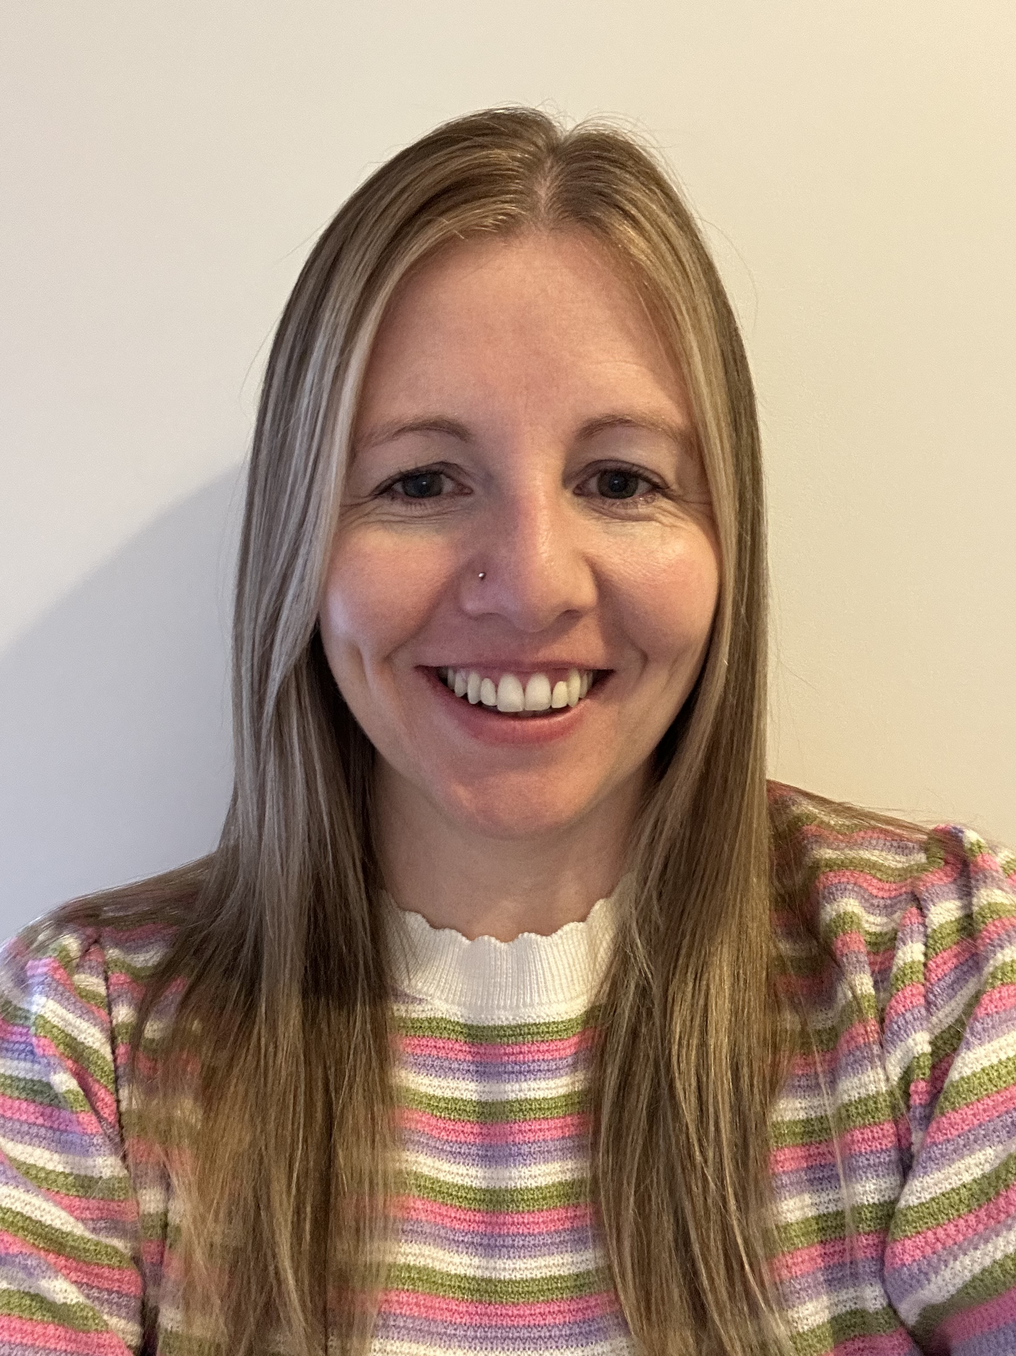
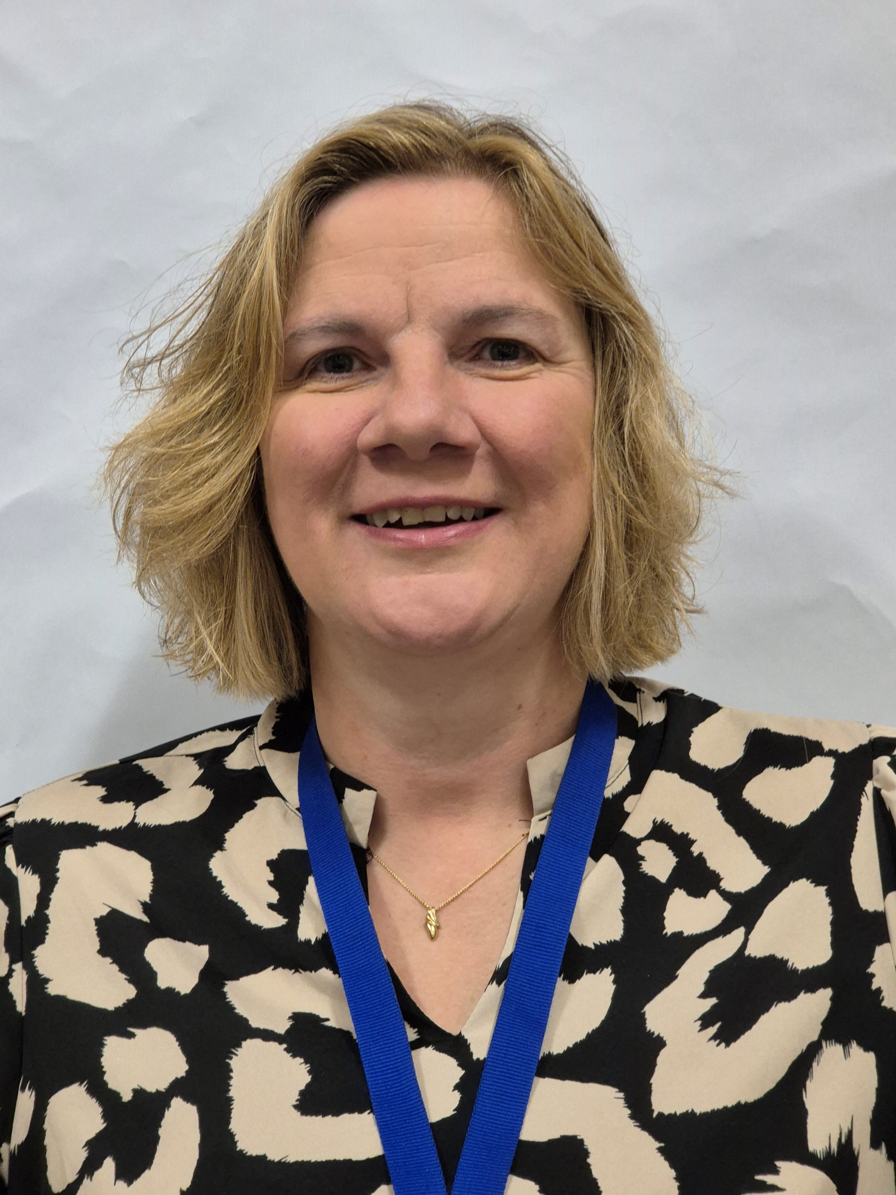

Staff you will see….
Mrs Jacobs
Assistant Head Teacher
Miss Moore
Deputy Head Teacher
Mrs Ryder-Smith
Head Teacher
Mrs Mitchell
Assistant Head Teacher
Mrs Compton
SENDCo and
Assistant Head Teacher

Slide 5
Who Do I speak to?
Class Teacher – year group email/drop off and pick ups
Inclusion Team – Mrs Wardle and Miss Adkin
SENDco – email the office/post sent to office

Slide 6
Routines….
Clothing
Please label all clothing
There are already lots of un-named jumpers in lost property!
Please have a look through the pile before you leave if you’re missing one!

Slide 7
Routines….
Drinks
Water only please in a labelled bottle.

Slide 8
Routines….
Coats
Please send your child with a coat (labelled!) when the weather is colder/wetter – we try to keep play time outside as much as possible!

Slide 9
Routines….
Reading
In school every day, in their reading folders,
RWI Zippy Wallets
1x coloured RWI book
1x black and white RWI book
Changed on weekly.
1x sharing book
Reading log
Please read with your child at least 4x per week.

Slide 10
Routines….
Numbots
Please use Numbots to practice basic number skills at home.
Letters have been sent home ☺

Slide 11
Routines….
PE
Outdoor PE
Wednesdays
PE kit needed
Shorts and t-shirt
Warm jumpers/tracksuits recommended for colder weather
Indoor PE
Monday
PE kit needed
Shorts and t-shirt

Slide 12
Routines….
  Dinners
If booking dinners on Relish, please make sure you have selected all of the options!

Slide 13
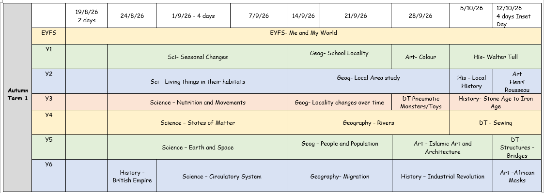
Topics covered this year….

Slide 14
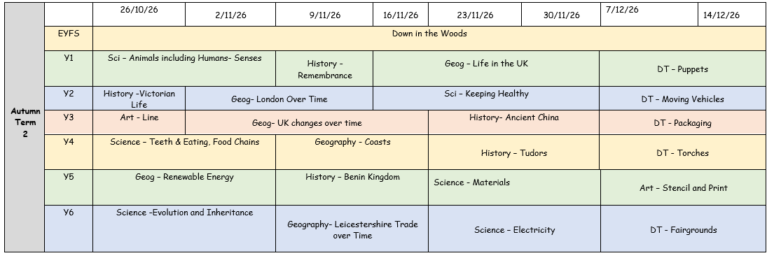
Topics covered this year….

Slide 15
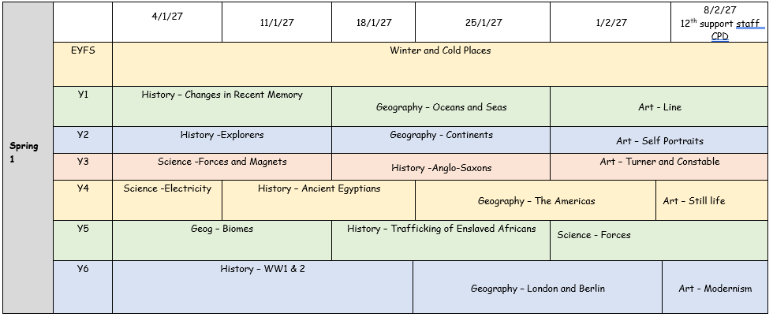
Topics covered this year….

Slide 16
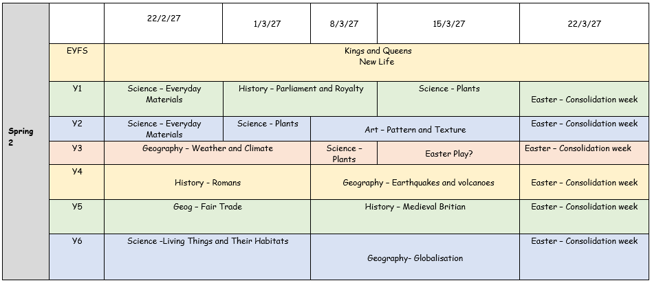
Topics covered this year….

Slide 17
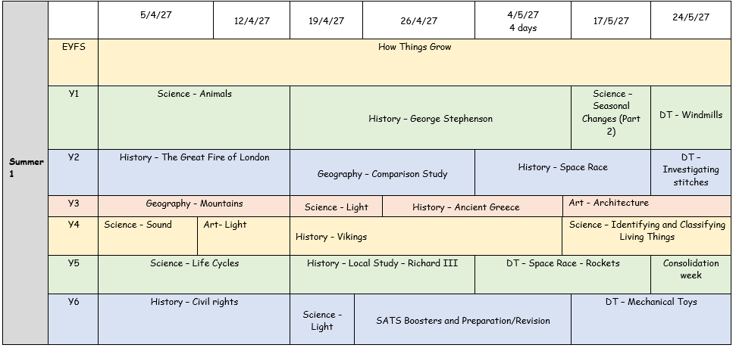
Topics covered this year….

Slide 18
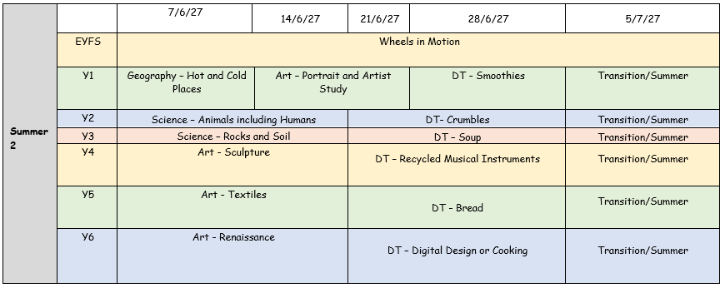
Topics covered this year….

Slide 19
Extra Special Info…
Only for children who did not pass their phonics assessment in year 1
Phonics screening in June (straight after half term)
Children will read 40 ‘real’ and ‘alien’ words. Focus on decoding using phonics. We will report your child’s result to you in your child’s school report.

Slide 20
Finally….
If you have any questions or concerns, please come and speak to us!
☺
Year2@ccsp.risemat.co.uk

