Slide 1

Welcome to EYFS

Slide 2
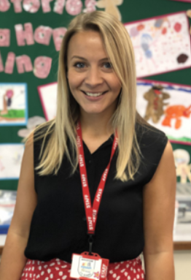
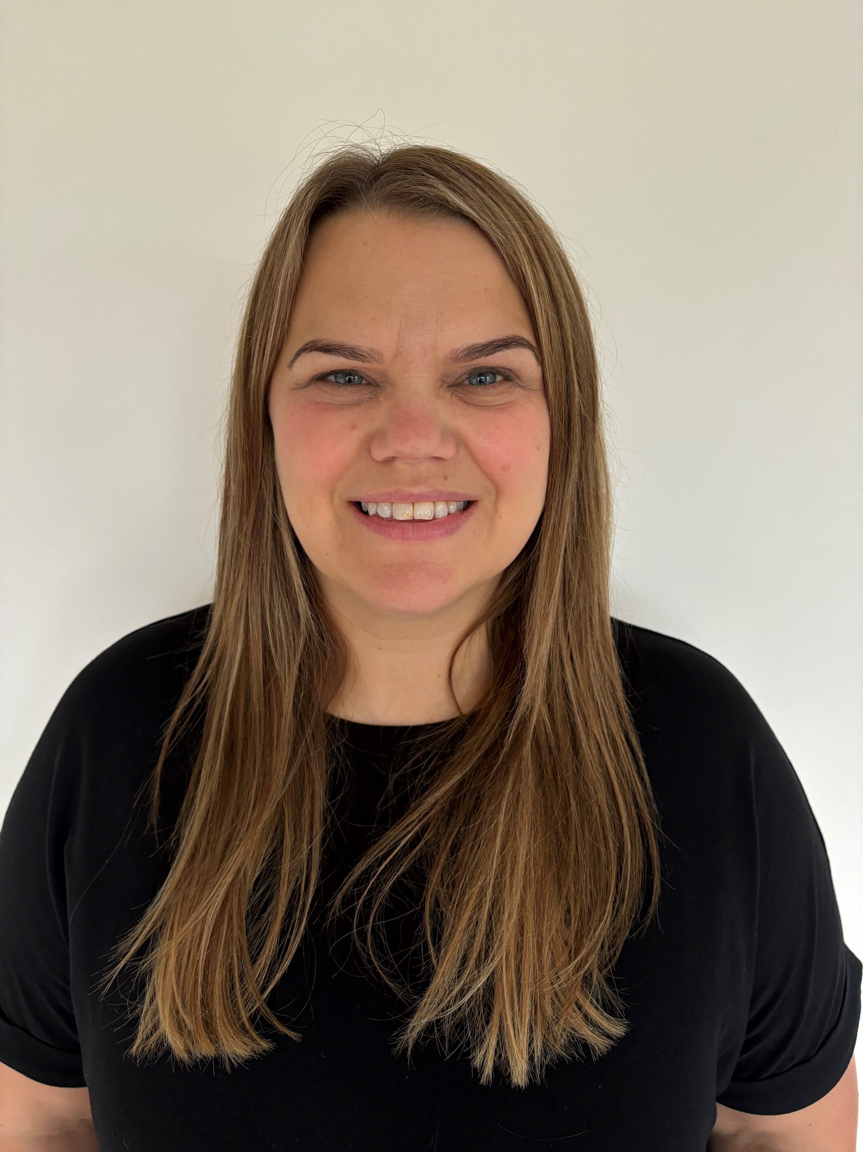
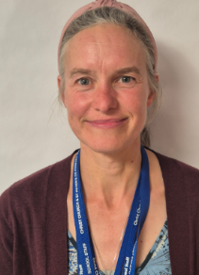
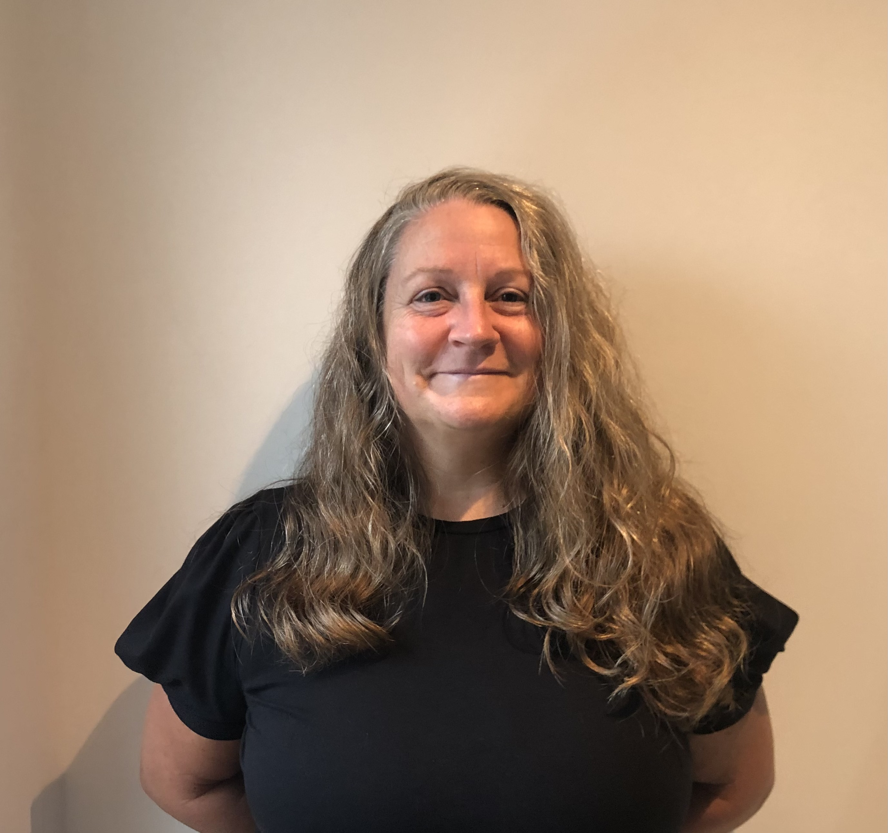
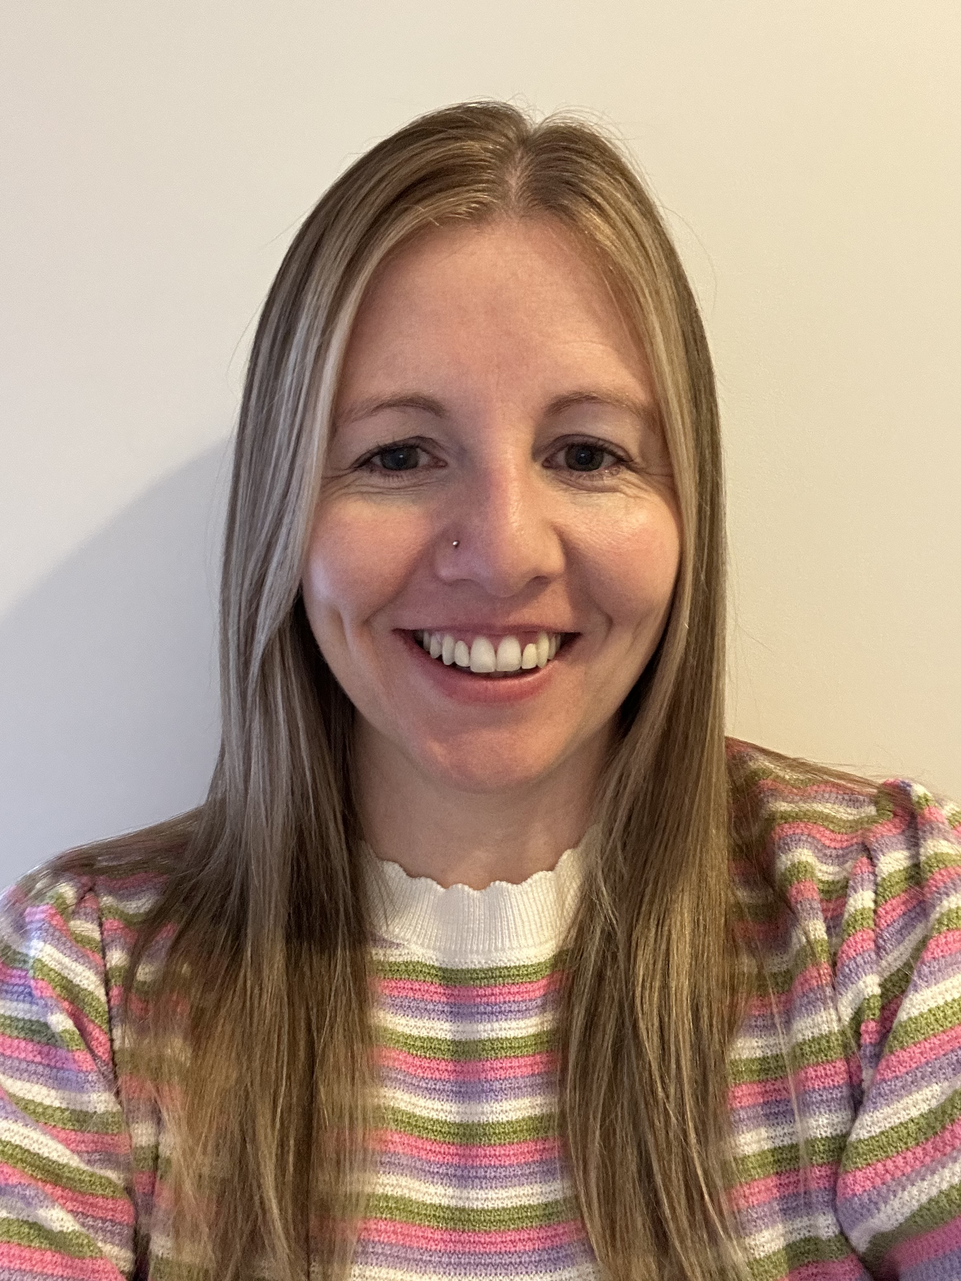
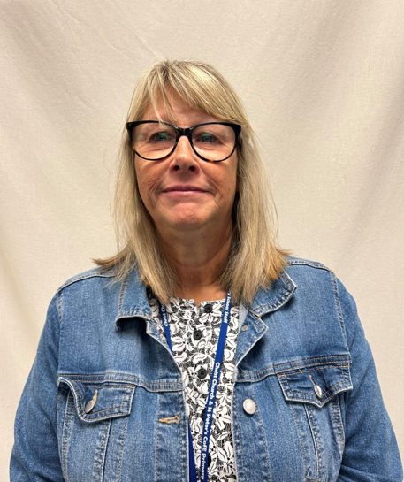
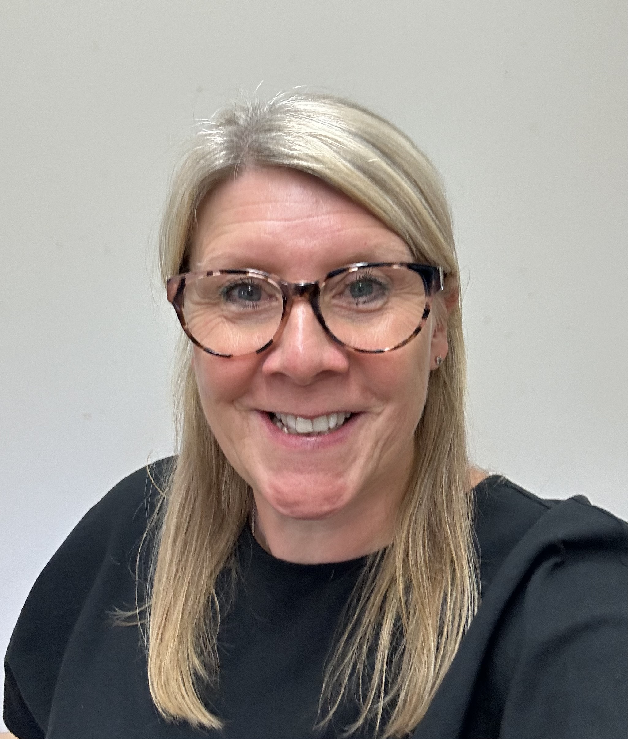
Staff you will see daily….
Mrs Bowyer
Miss Moore
Mrs Mitchell
Mrs Mount
Mrs Wardle
Mrs Shepherd
Mrs Wardle

Slide 3
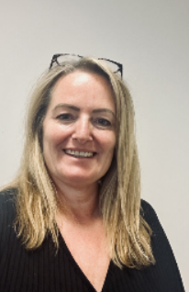
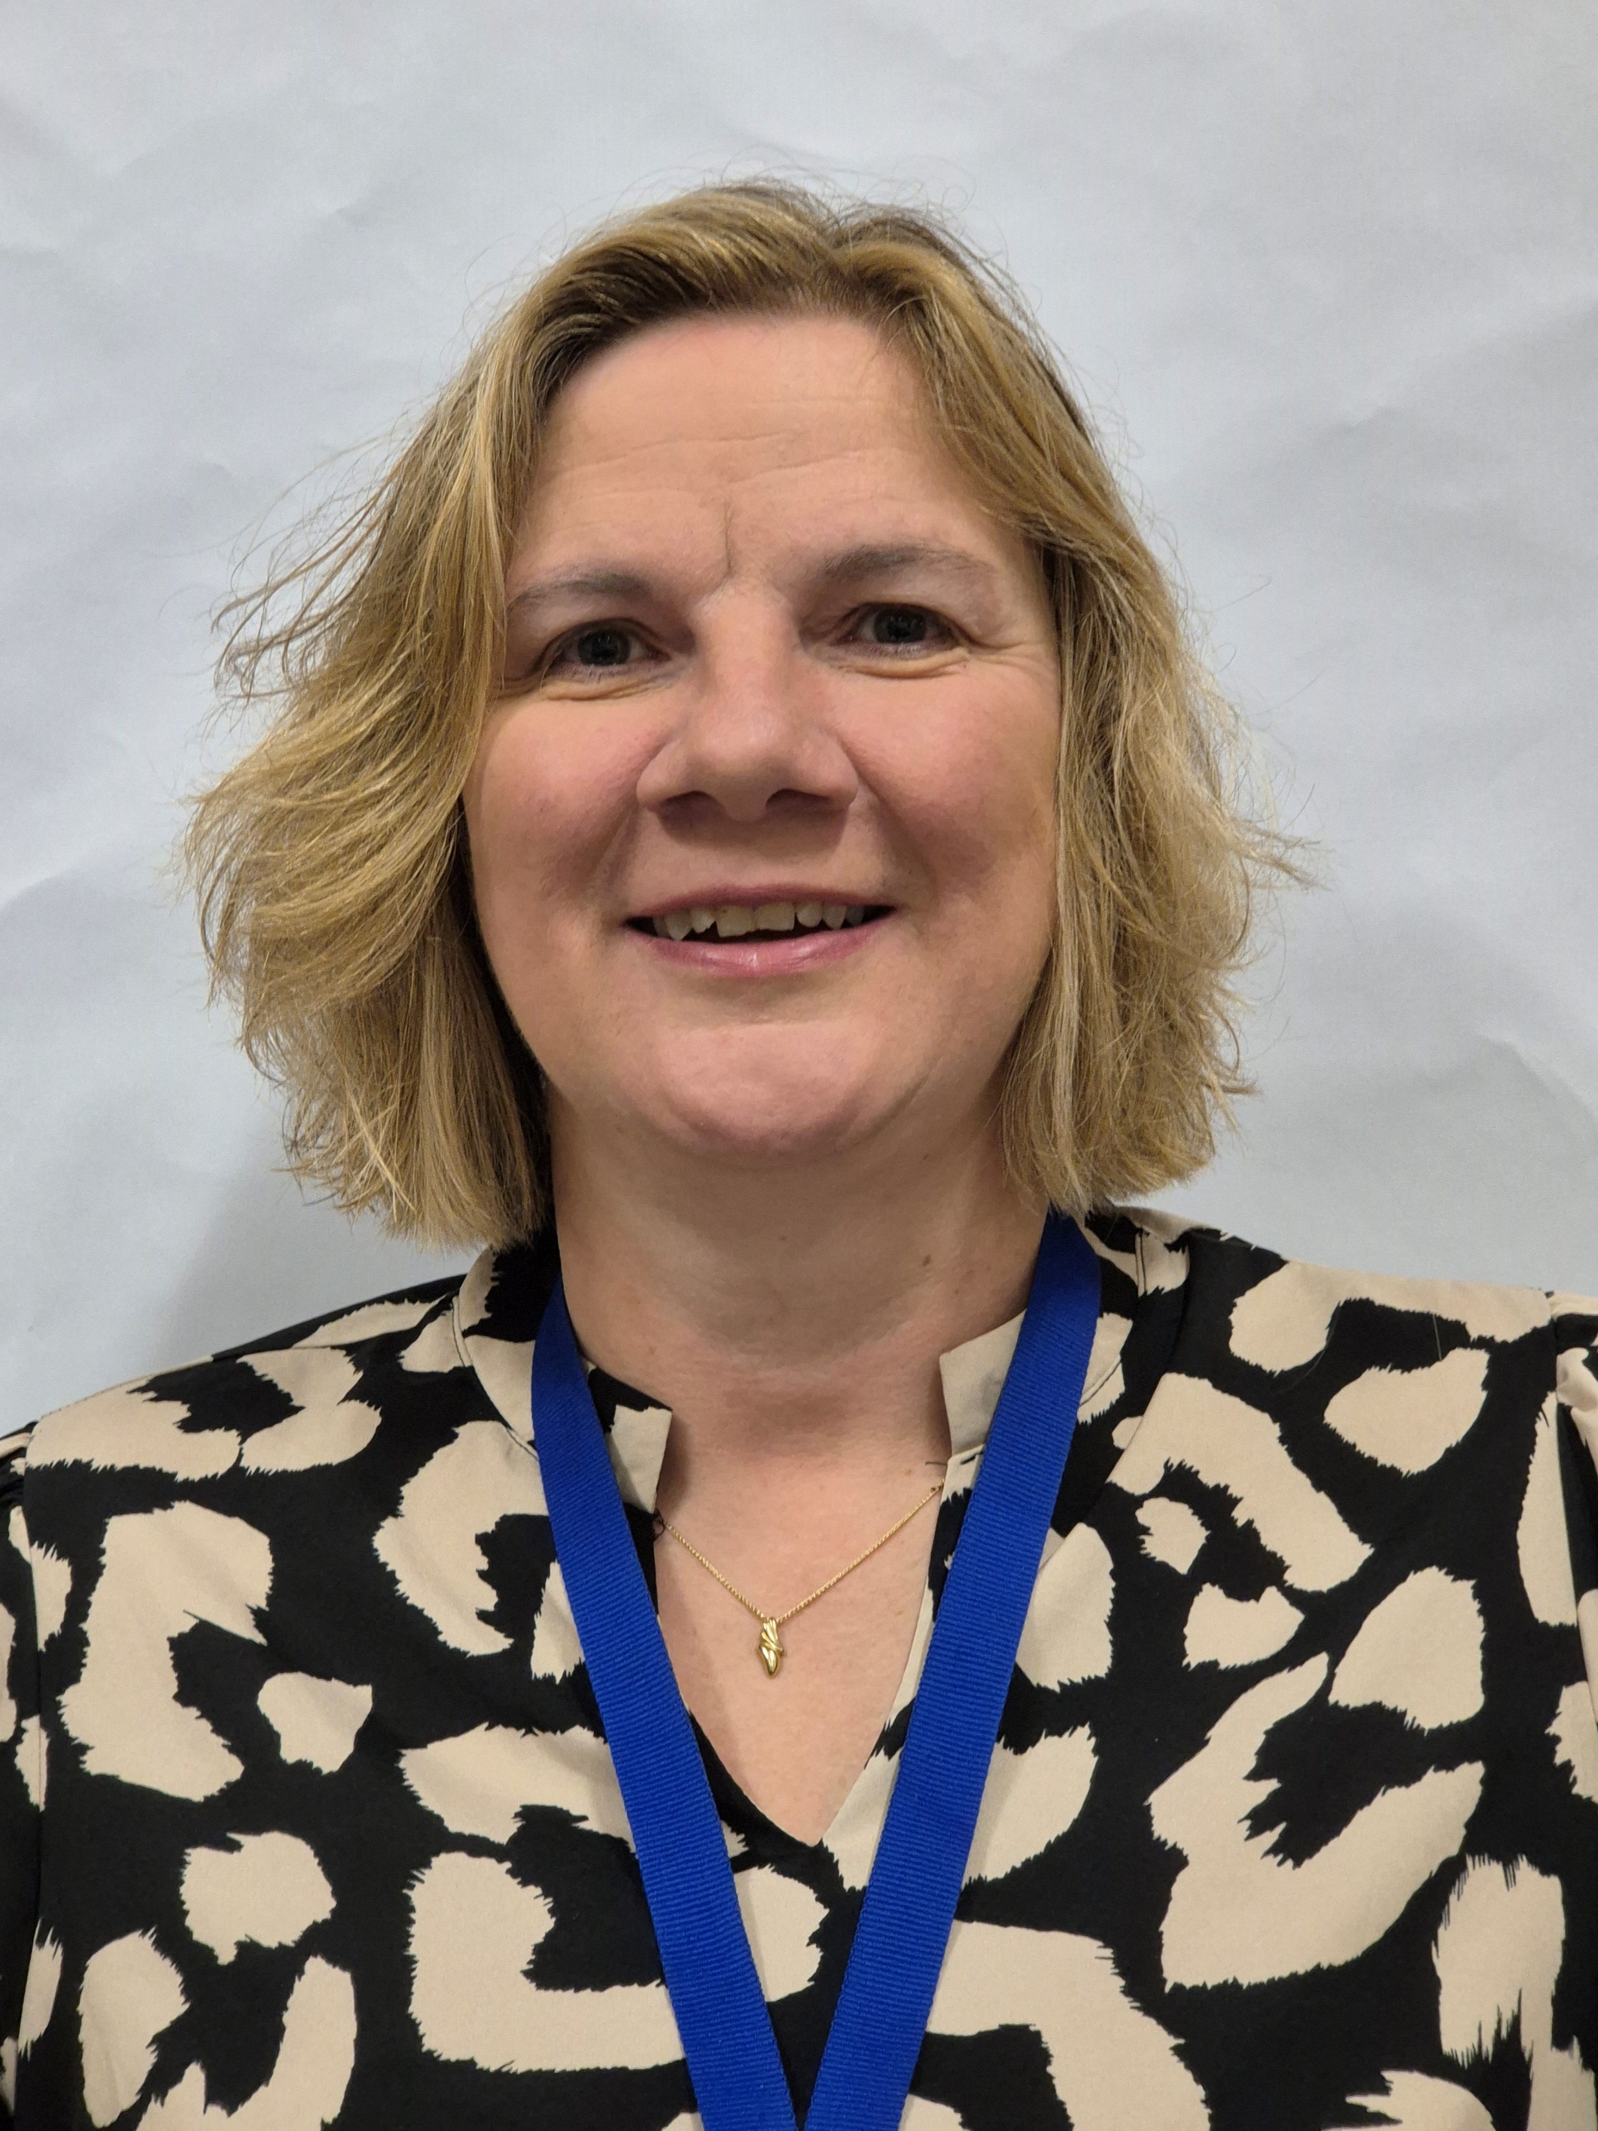

Senior Leadership Team
Mrs Ryder-Smith
Headteacher
DSL
Miss Moore
Deputy Headteacher
DDSL
Mrs Compton
SENDCo
Assistant Headteacher
DDSL
Mrs Mitchell
Assistant Headteacher
DDSL
Mrs Jacobs
Assistant Headteacher
DDSL

Slide 4
Routines….
PE is on a Tuesday – we will start this around half term! We will be building up to getting fully changed!
Water Bottles – Need to be in school every day but we do have cups if you forget. Children will refill bottles if empty. Water where possible please ☺
Spare Clothes – accidents happen! Please have spare clothes including pants and socks. We do have spare clothes if needed but please wash and return ASAP.
Outdoor Learning – We go into outdoor provision in ALL weathers! Dress for the weather!
Snacks – fruit is provided everyday but feel free to send in your own fruit. Please cut grapes up!

Slide 5
Routines….
Reading - Every child will have a reading folder that will go into their book bags.
To begin with your child will start with a wordless book and a sharing book.
We are using a new phonics scheme this year called ‘Sounds-Write’. Please take an information leaflet.
Eventually your child will have a Sounds Write book to match their phonics learning.
Keep everything in the bookbag so it is in school everyday!

Slide 6
Topics covered this year….
Autumn Term
All About Me!
A Colourful World
Summer Term
Growing – Farm Visit!
Wheels in Motion
Spring Term
Frozen Planet
Kings and Queens – Fundraising event

Slide 7
Extra Special Info…
Government Assessment - At the end of the year we have to make a judgement if your child has met the ‘Early Learning Goal’. There are 17 areas to assess. You will be kept informed throughout the year (Emerging or Expected)
Nativity!
We are available to chat at the end of the day. Mornings are quite busy so we can take quick messages only.
Tapestry – check regularly for updates, key information, photos and any messages. We aim to add one post each week for individual children.
EYFS Mailbox – eyfs@ccsp.risemat.co.uk

